Slide 1
Dr.SNS RAJALAKSHMI COLLEGE OF ARTS AND SCIENCE
(AUTONOMOUS)
Accredited by NAAC (Cycle-III) with ‘A+’ Grade
Department of Mathematics
COURSE : FUZZY LOGIC AND NEURAL NETWORKS
Topic: Equivalence & Tautology truth table
S.REKHA
Assistant Professor
Dept. of Mathematics
Dr. SNSRCAS

Slide 2
I. LOGICAL EQUIVALENCE TRUTH TABLE
EQUIVALENCE TRUTH TABLE
Two statement forms are logically equivalent if, and only if, their resulting truth tables are identical for each variation of statement variables.

Slide 3
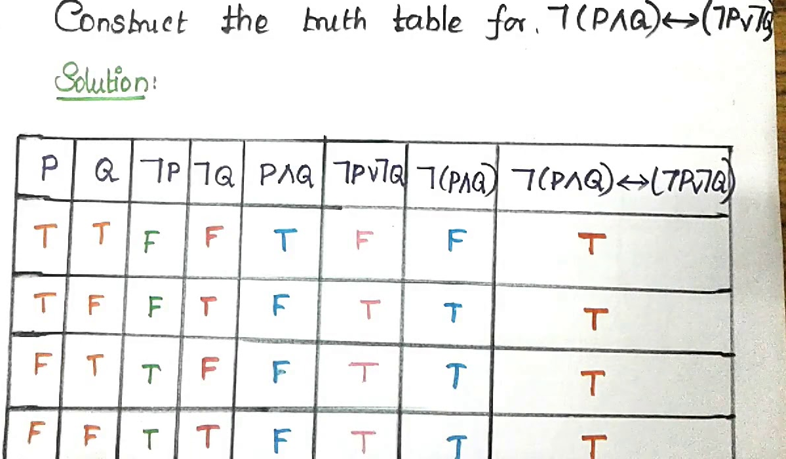
LOGIC CONNECTIVES

Slide 4
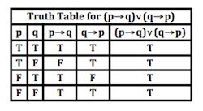
Tautology
A tautology is a compound statement that will always be true for every value of individual statements. A Greek word is used to derive the tautology where 'tauto' is known as "same" and "logy" is known as logic. There are some conditional words, which is used to make a compound statement

Slide 5
THANK YOU

